Slide 1
Version Control System
What is Version Control System?
Why we need Version Control System?
Types of Version Control Systems
Git/GitHub Software’s
Different Commands

Slide 2
What is Version Control System?
A version control system or VCS, also know as revision control or source control system, is a software utility that tracks and manages changes to a filesystem. A VCS also offers collaborative utilities to share and integrate these filesystem changes to other VCS users.

Slide 3
Why we need Version Control System?
VCS is used for Files Version Maintenance
VCS is used for Tracking the Software file status
VCS is used for Sharing

Slide 4
Types of Version Control Systems
Centralized Version Control System(Ex: SVN)
Distributed Version Control System(Ex: Git/GitHub)

Slide 5
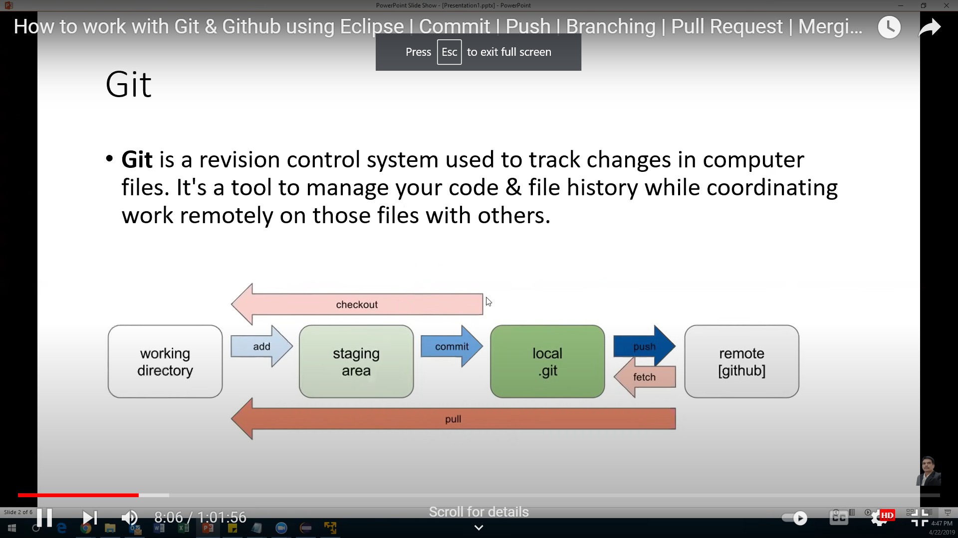
Git Architecture

Slide 6
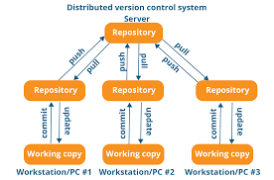
GitHub Architecture

Slide 7
Git/GitHub Commands
Init
Status
Commit
Push
Pull/Fetch
Branching
Merging
Rebasing
Raising Pull Request(PR)
Approve Pull Request(PR)

Slide 8
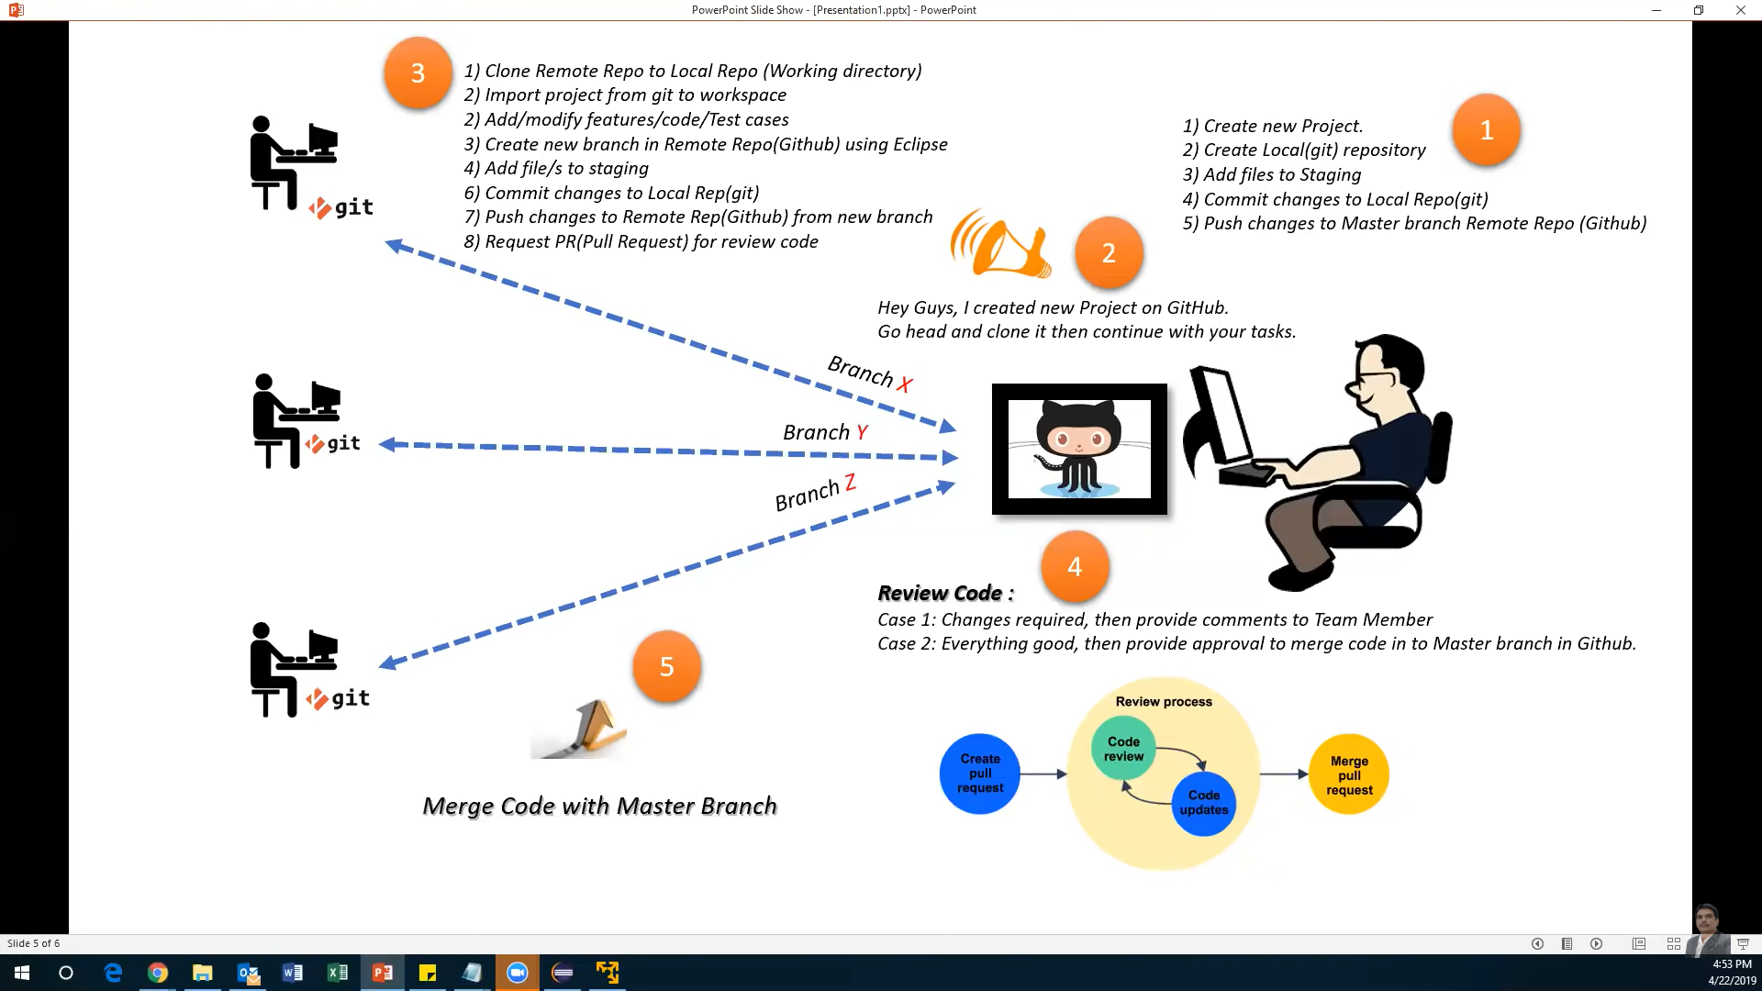
End to End Process

Slide 9
Reference
Git Repository : this is a Navigation panel that allows to browse through the files and provides options to GIT actions such as (push, pull, fetch, etc)
Git Staging : This section shows all the files that have been changed on the local and are due to be sent to remote repository (Github cloud). We can provide comments and commit the new changes from here.
Local Repository : local copy of the code , this is the private workspace where developers can make code changes.
Remote Repository/Upstream : centralized code repository (server or cloud) where all developers synchronize / upload / download code from.
Branches : different branches allows us to baseline different versions , different features.
Tags : tags are used to mark milestone in the application. Usually a stable code base or new feature or new code launch.
Pull : right click on project in git repository and select pull. This option allows us to download the latest code from centralized github cloud.
Push : right click on project in git repository and select push to upstream. This option allows us to upload the local updated code to centralized github cloud.
Fetch : right click on project in git repository and select fetch from upstream. while performing push operation if there were other changes uploaded/committed by other developers , push operation will be rejected. Fetch allows us to download these changes in local for resolving conflict or merge or rebase.
Merge : right click on project in git repository and select Merge. Merge option allows us to keep track of all commits and historical changes committed by different developers in single timeline. Use if there are lot of developers working and committing on main branch and if you would like to keep track of all historical changes and commits.
Rebase : right click on project in git repository and select Rebase. Rebase realigns the original branch to new commits. This allows us to realigns, edit commits. This integration pretends as if the changes were done by everyone sequentially. Use when your code changes are more active on the GIT and you would like to keep clean but not accurate history of commits.

